Slide 1

Infertilità nella donna con obesità: trattamento dietetico-comportamentale
Anna maria barile
DIETISTA-AOU PAOLO GIACCONE
Psd Nutrizione clinica, obesità e malattie del metabolismo

Slide 2
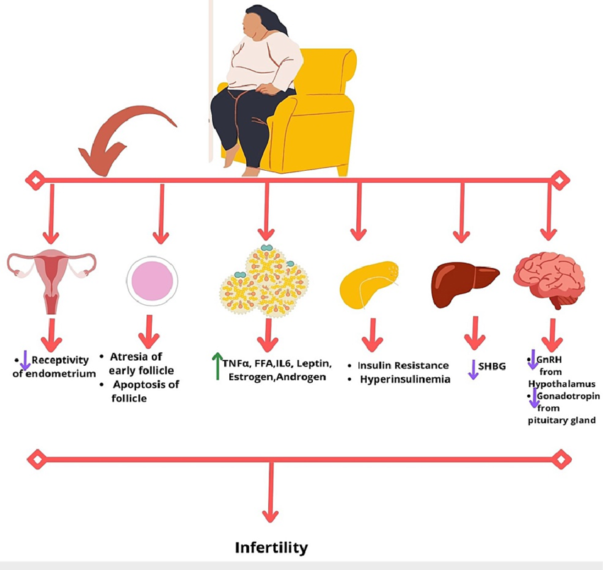
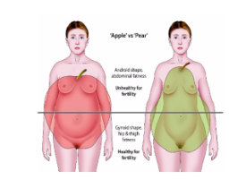
Infertility is one of the comorbidities associated with obesity
Fat distribution appears to have a greater impact on fertility than age
(a 0.1-unit increase in the W/H ratio reduces the probability of conception by 30%)
Ahmad R, Haque M. Obesity: A Doorway to a Molecular Path Leading to Infertility. Cureus. 2022 Oct 27;14(10):e30770.

Slide 3
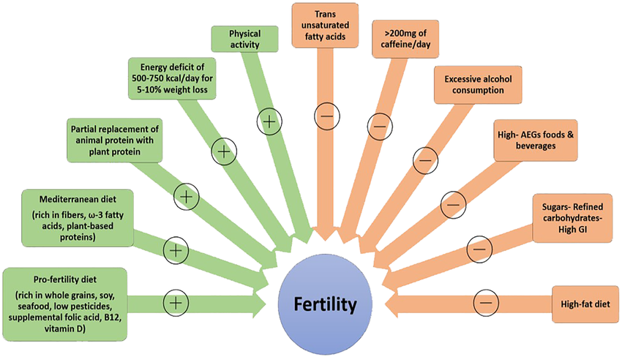
Lifestyle factors potentially affecting fertility
Gitsi et al. Nutritional and exercise interventions to improve conception in women suffering from obesity and distinct nosological entities. Front Endocrinol (Lausanne). 2024 Jun 28;15:1426542.

Slide 4
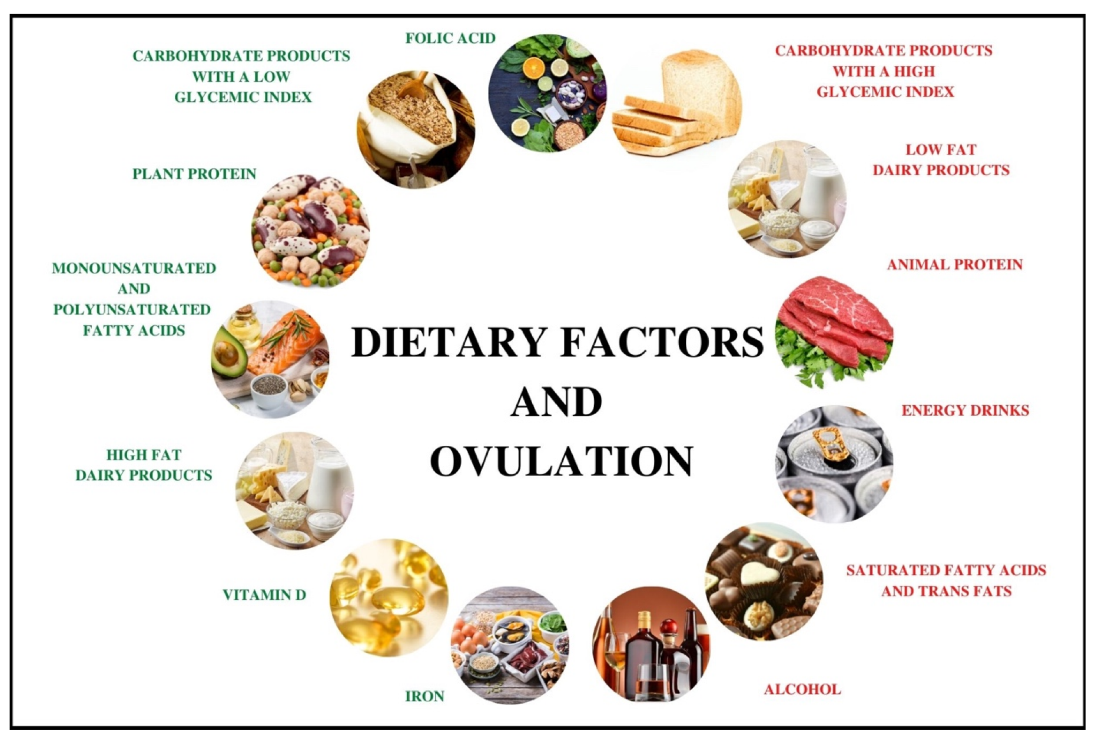
The influence of dietary factors on the risk of ovulation disorders
Ovulation is positively influenced by components typical of the Mediterranean diet (e.g., low glycemic index carbohydrates, plant protein, and unsaturated fatty acids)
Components typical of the Western diet have a negative effect (e.g., animal protein, carbohydrates with a high glycemic index, and saturated fatty acids)

Slide 5
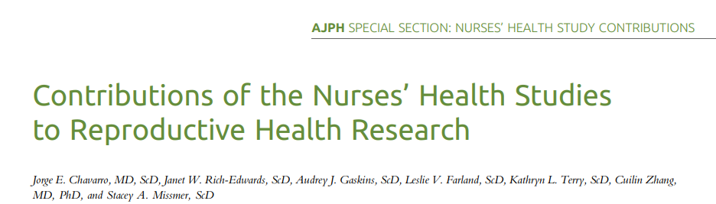
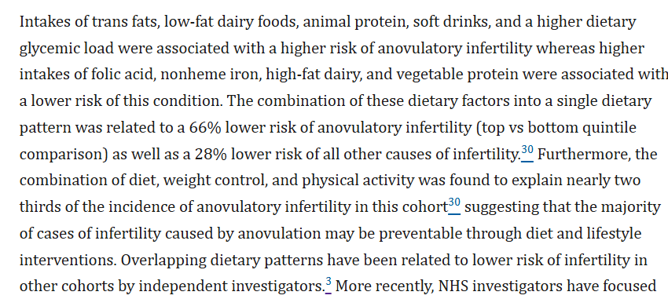

Slide 6
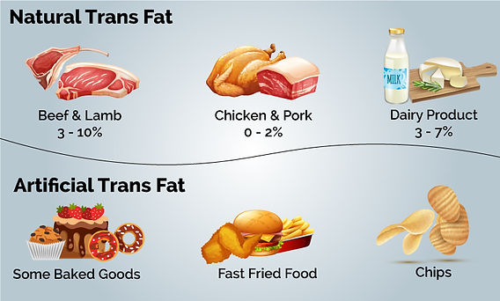

Alimento | 100 g di parte edibile
Margarina | 14,89 | g
Torta di mele (McDonald's) | 6,126 | g
Gamberetti fritti | 4,195 | g
Glassa al cocco | 3,748 | g
Burro | 3,278 | g
Carne macinata (25% grasso) | 1,529 | g
Torta al cioccolato | 1,318 | g
Doppio Cheeseburger (McDonald's) | 0,857 | g
Wurstel di tacchino | 0,789 | g
Cheeseburger (Burger King) | 0,777 | g
Omelette | 0,709 | g
Cheeseburger (McDonald's) | 0,647 | g
Uova strapazzate | 0,624 | g
Cervello di manzo | 0,61 | g
Taco con carne, formaggio e lattuga | 0,467 | g
Crackers | 0,443 | g
Trans fatty acids are a type of unsaturated fat found naturally in meat and dairy from ruminant animals and produced industrially through partial hydrogenation of oils for food production, resulting in partially hydrogenated oils used in baked goods, fried foods, and margarines
1% naturally present
99%
For hydrogenation, refining and cooking

Slide 7
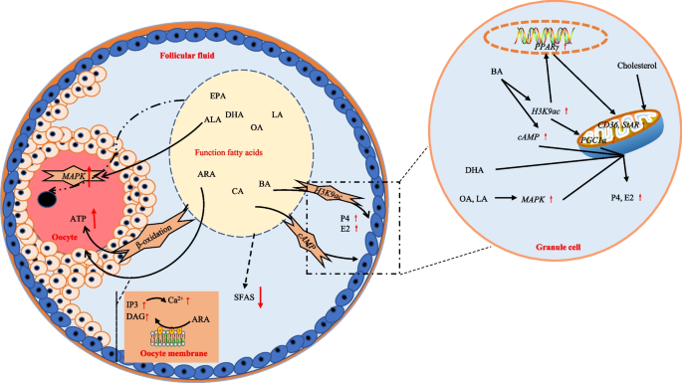
Trans-fatty acids were found to negatively impact ovulatory function in women.
Possible mechanisms may involve binding to peroxisome proliferator-activated receptor(PPAR) and thus modulating its expression.
PPAR is known to be implicated in different ovarian functions such as follicular rapture, corpus luteum formation and steroid hormones metabolism. Increased intake of trans fatty acids also leads to insulin resistance and an increase in inflammatory markers.

Slide 8

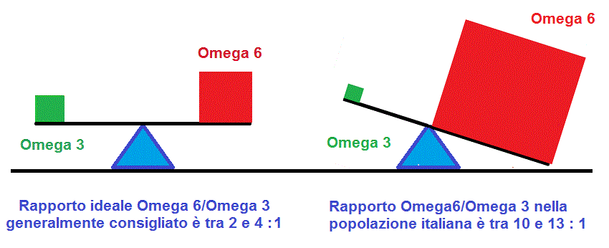
Choose mono and polyunsaturated fatty acids
RATIO ω6:ω3
changes in the number and size of follicles, ovulation, and progesterone production by the corpus luteum

Slide 9
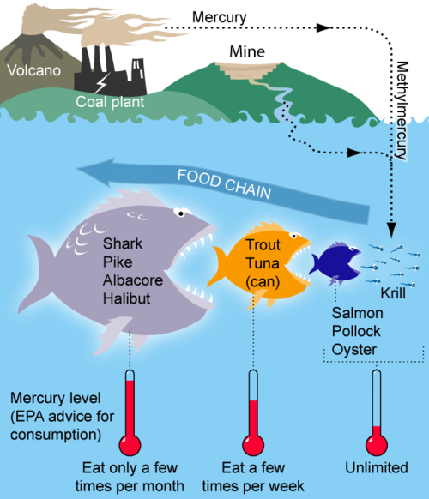

Sources of anthropogenic pollution such as coal burning and iron mining can contaminate water sources with methylmercury, which is easily absorbed into fish bodies. Through the process of biomagnification, mercury levels increase with each subsequent predatory phase.
EFSA has established the following tolerable weekly limits (TWI) for mercury:
4 µg/kg body weight for inorganic mercury
1.3 µg/kg body weight for methylmercury.

Slide 10

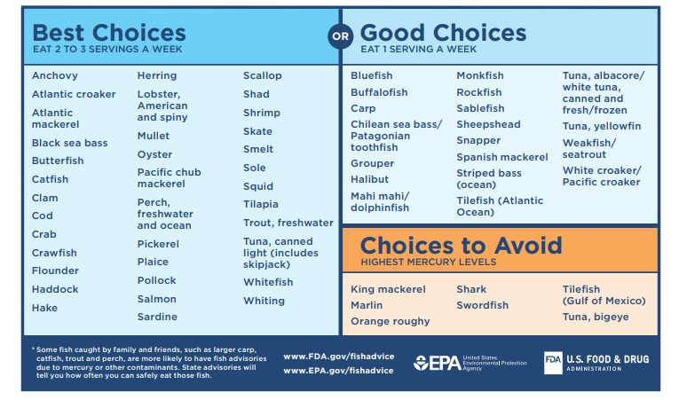
High levels of mercury can cause a cytotoxic and genotoxic effect, which damages cells and DNA, compromising the quality of oocytes and reproductive capacity

Slide 11
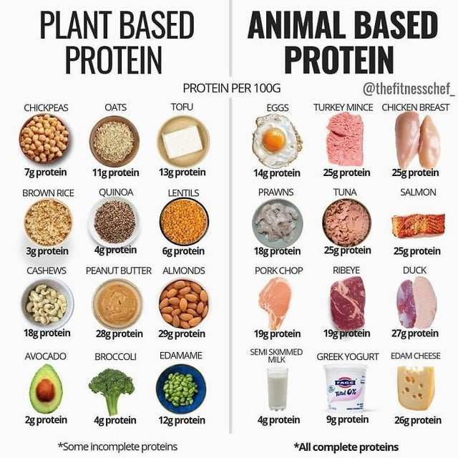

Less animal protein and more proteins of plant origin
Protein intake should align with recommendations for the
general population, considering factors such as physical activity
levels, and it is advisable to prioritize plant protein sources.
The prospective Nurses Health Cohort Study II (NHS II) indicated
that substituting 5% of energy from animal protein with plant protein could decrease anovulatory infertility risk by more than 50%.
This outcome may stem from the varying impacts of plant and animal proteins on insulin and insulin-like growth-factor I (IGF-I) secretion, with plant protein’s potential fertility benefits likely arising from its weaker insulin response compared to animal protein.
3:1 ratio
in favor of vegetable proteins

Slide 12
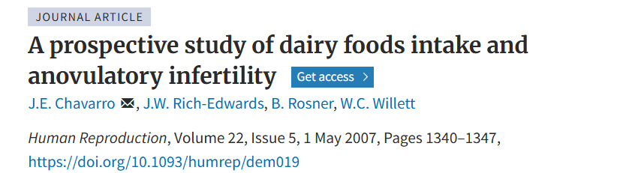

High fat/ Whole - Dairy
Nurses’ Health Study II
In summary, we observed a positive association between intake of low-fat dairy foods (especially yogurt and sherbet/frozen yogurt) and anovulatory infertility and an inverse association between intake of high-fat dairy foods (especially whole milk and ice cream) and this disease.
The intake of dairy fat, or a fat-soluble substance present in dairy foods, may partly explain the association between high-fat dairy and anovulatory infertility. Further, our data do not support the hypothesis that, within the observed range of intake, lactose significantly impairs ovulatory function to the point of affecting fertility.

Slide 13
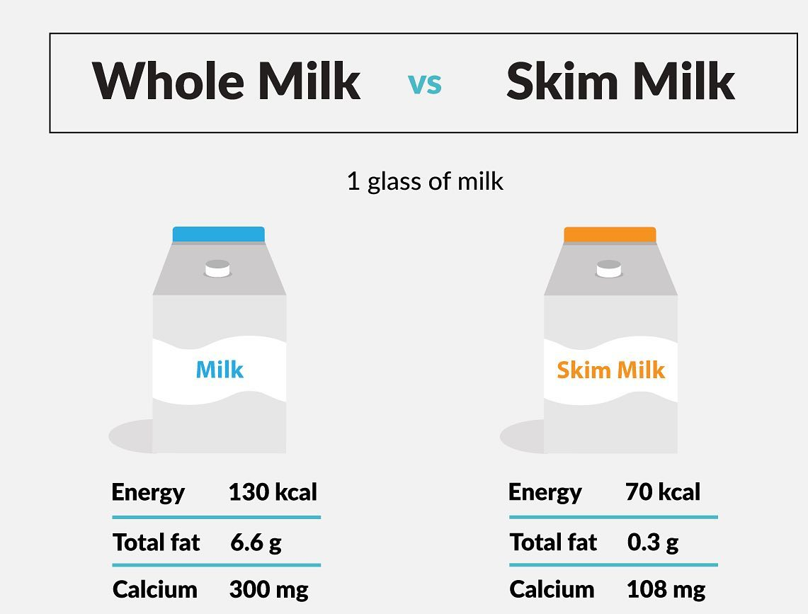
Componente / Ormone | Latte intero | Latte scremato | Effetto potenziale sulla fertilità
Estrogeni (estradiolo, estrone) | ✔ Maggiore quantità (liposolubili) | ✘ Ridotto contenuto | Favoriscono l’equilibrio ormonale femminile
Progesterone | ✔ Presente in concentrazione più alta | ✘ Quantità molto ridotta | Supporta la funzione ovarica e la fase luteale
Vitamina D (liposolubile) | ✔ Più biodisponibile grazie alla presenza di grassi | ✘ Minore assorbimento in assenza di grassi | Coinvolta nella regolazione ormonale e nella fertilità
IGF-1 | ✔ Presente | ✔ Presente | Stimola la crescita ovarica; effetto controverso
Insulina | ✔ Presente in quantità moderate | ✔ Più concentrata | Potenziale impatto negativo su insulino-resistenza
Grassi (veicolo ormoni) | ✔ Presenti (veicolano ormoni liposolubili) | ✘ Assenti o quasi | Essenziali per l'assorbimento di ormoni e vitamine
Impatto metabolico | ✔ Maggiore sazietà, risposta glicemica stabile | ✘ Possibile maggiore impatto glicemico | Latte intero può ridurre il rischio di disturbi ovulatori
The reason may be related to the lipid content and fat-soluble hormones present in full-fat dairy products, which can positively influence female hormonal balance and ovarian function. Skimmed dairy products, on the other hand, appear to be associated with a higher incidence of ovulatory disorders, possibly due to their different impact on insulin and sex hormones.

Slide 14
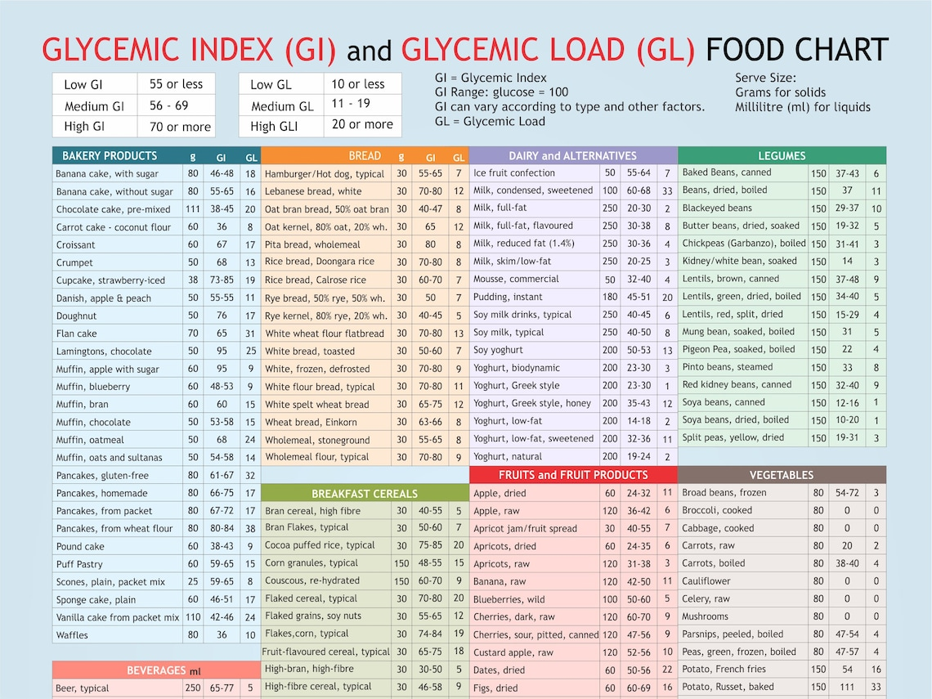
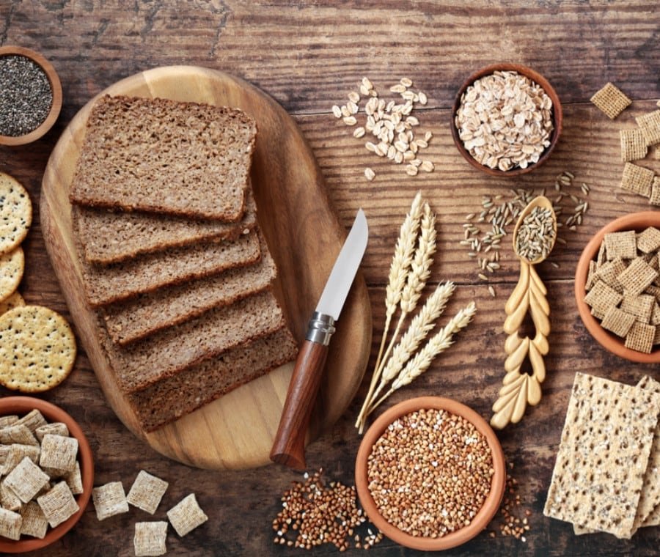
Low glycemic index and glycemic load
A low glycemic index e load diet helps stabilize insulin and glucose levels, improving ovulation, hormonal balance, and oocyte quality — all essential for increasing the chances of conception.

Slide 15
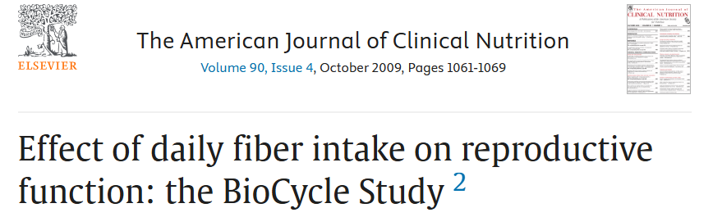
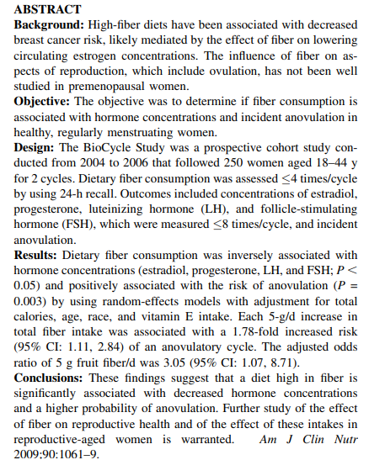

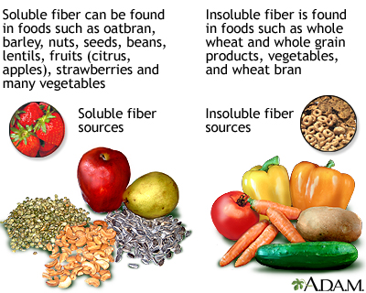

Slide 16
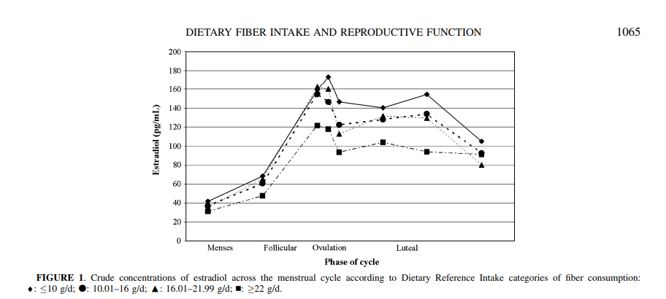
Dietary fiber was stratified into insoluble and soluble components, yielding results similar to those of total dietary fiber. Soluble fiber had a stronger inverse relation with estradiol concentrations (β= 0.222, P= 0.01) than did insoluble fiber (β= 0.057, P= 0.02). Of the 3 sources of fiber, fruit fiber had the strongest association with concentrations of estradiol (β= 0.104, P= 0.03), followed by grain fiber (β= 0.073, P= 0.03), whereas vegetable fiber was not associated (β= 0.027, P= 0.40) with estradiol concentration. Fruit and grain fiber were also associated with statistically significant decreases in concentrations of progesterone (β= 0.242, P= 0.02, for fruit fiber, and β= 0.163, P= 0.02, for grain fiber).

Slide 17
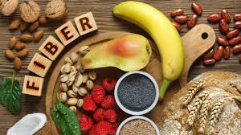
Anovulation
Results from a nonlinear mixed model adjusting for energy intake, race, age, and vitamin E intake showed that for each 5-g increase in dietary fiber, the adjusted odds ratio (aOR) of anovulation was 1.78 (95% CI: 1.11, 2.84; Table 3).
Thus, a 5-g/d increase in dietary fiber intake, equivalent to ≈2 slices whole-grain bread (4.6 g/d) or one large apple (4.7 g/d), would result in a 78% elevation in the risk of anovulation. Analysis of continuous soluble and insoluble fiber intake as linear exposures yielded similar results. Soluble fiber had a stronger, positive association with an elevated risk of anovulation (aOR: 6.73; 95% CI: 1.18, 38.26) than did insoluble fiber (aOR: 2.15; 95% CI: 1.22, 3.77).
In conclusion, we observed that fiber consumption at or above the recommended intakes (22g/die) was significantly associated with decreased reproductive hormone concentrations and a substantially elevated probability of anovulatory cycles in women of reproductive age.

Slide 18
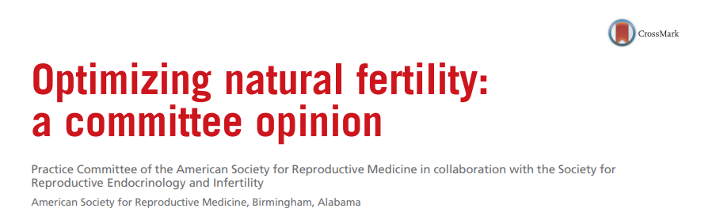
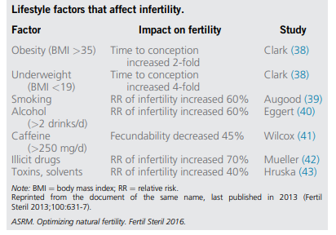
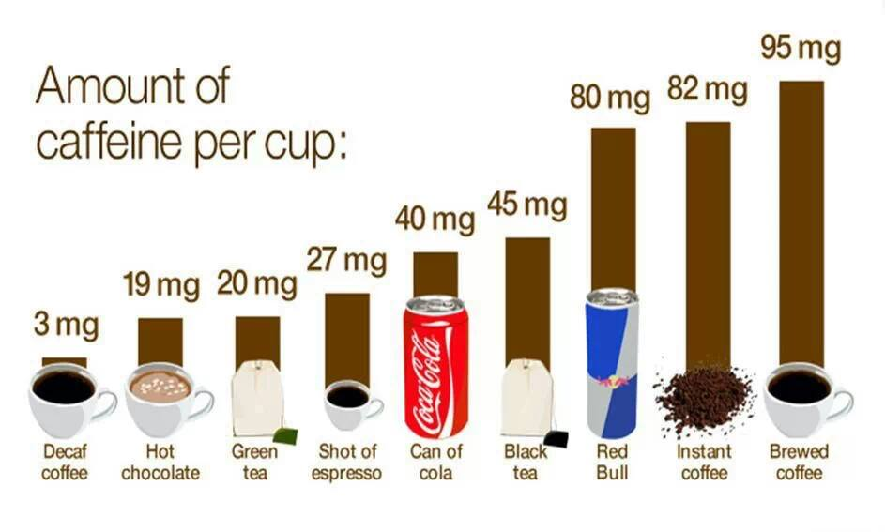
Alcoholic beverages and caffeine

Slide 19
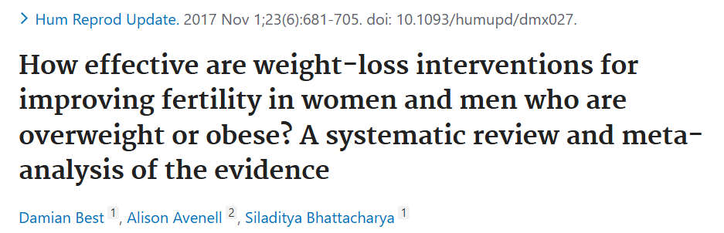
OUTCOMES:
A total of 40 studies were included, of which 14 were randomised control trials. Primary outcomes were pregnancy, live birth rate and weight change. In women, reduced calorie diets and exercise interventions were more likely than control interventions to result in pregnancy [risk ratio 1.59, 95% CI (1.01, 2.50)], and interventions resulted in weight loss and ovulation improvement, where reported. Miscarriage rates were not reduced by any intervention.
WIDER IMPLICATIONS: Overweight and obese persons seeking fertility should be educated on the detrimental effects of fatness and the benefits of weight reduction, including improvement in pregnancy rates. A combination of a reduced calorie diet, by reducing fat and refined carbohydrate intake, and increased aerobic exercise should form the basis of programmes designed for such individuals. A lack of randomized studies in men and couples, and studies evaluating barriers to undertaking weight loss in infertile populations is evident, and future research should examine these issues further.

Slide 20
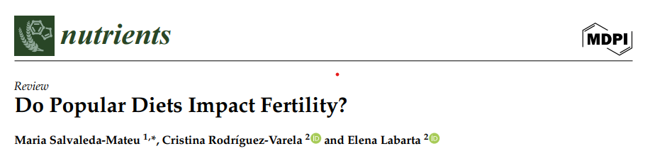
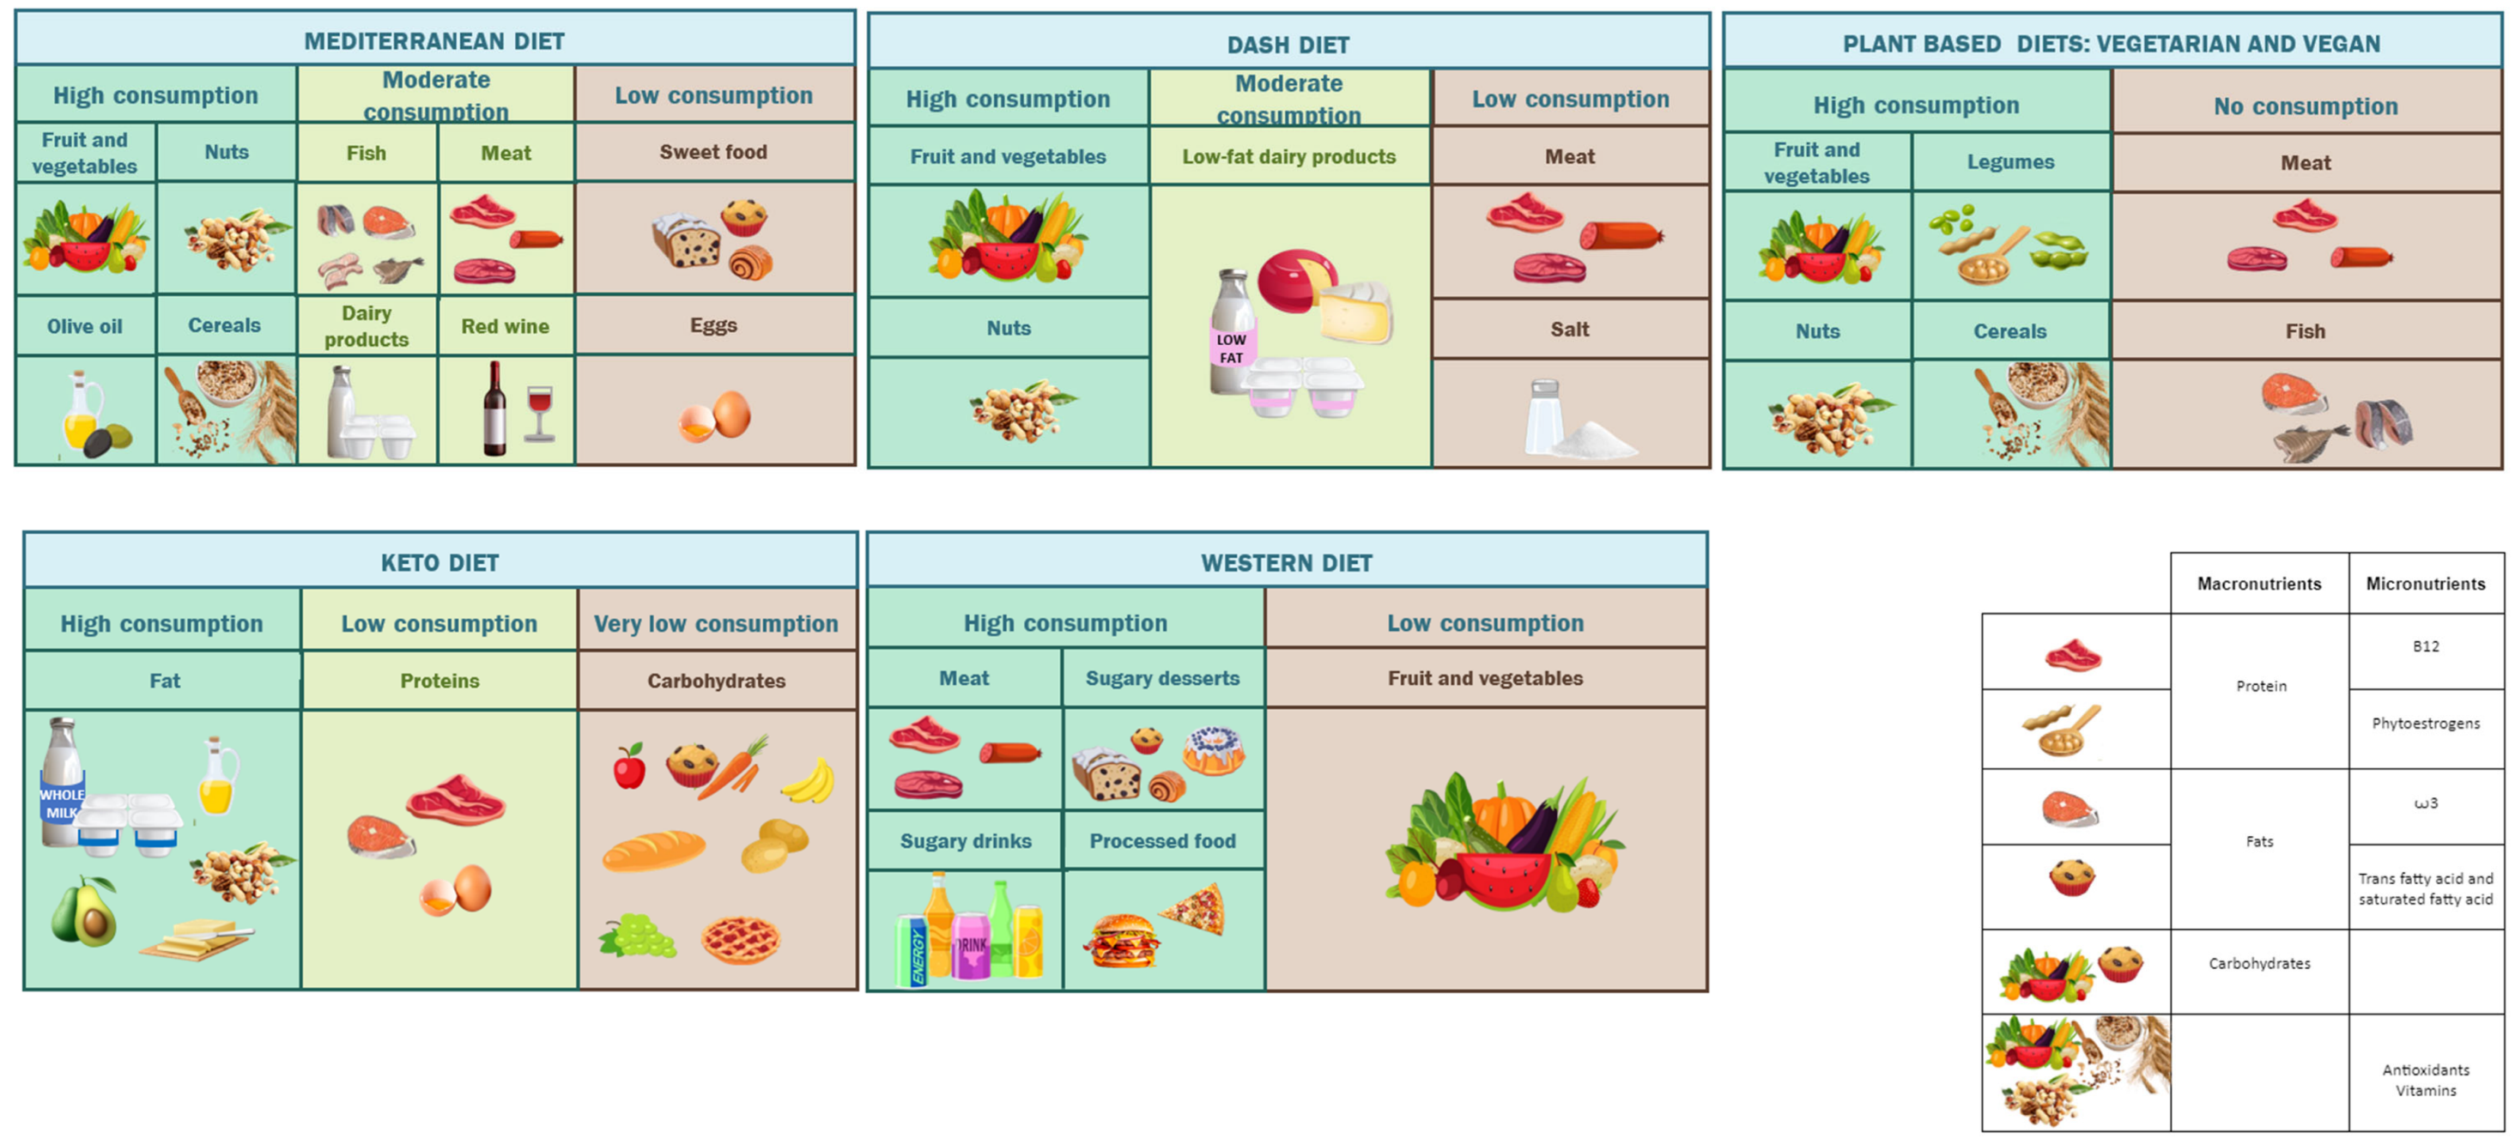

Slide 21
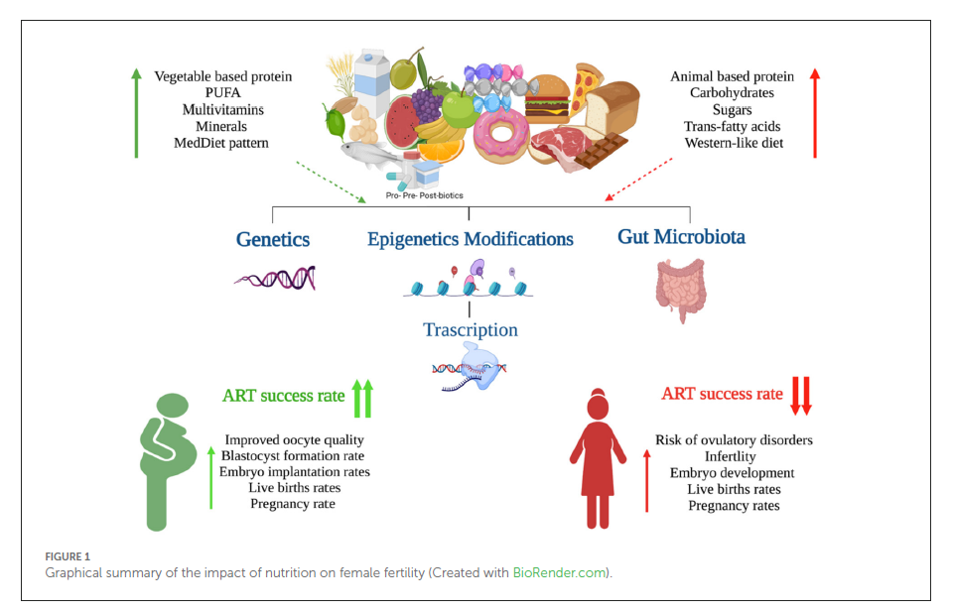
In a study that compared ART outcomes in patients with various prepregnancy dietary patterns, researchers identified the Mediterranean diet pattern, to be most associated with fertility.
The Mediterranean diet resulted in a 40% greater probability of pregnancy.

Slide 22
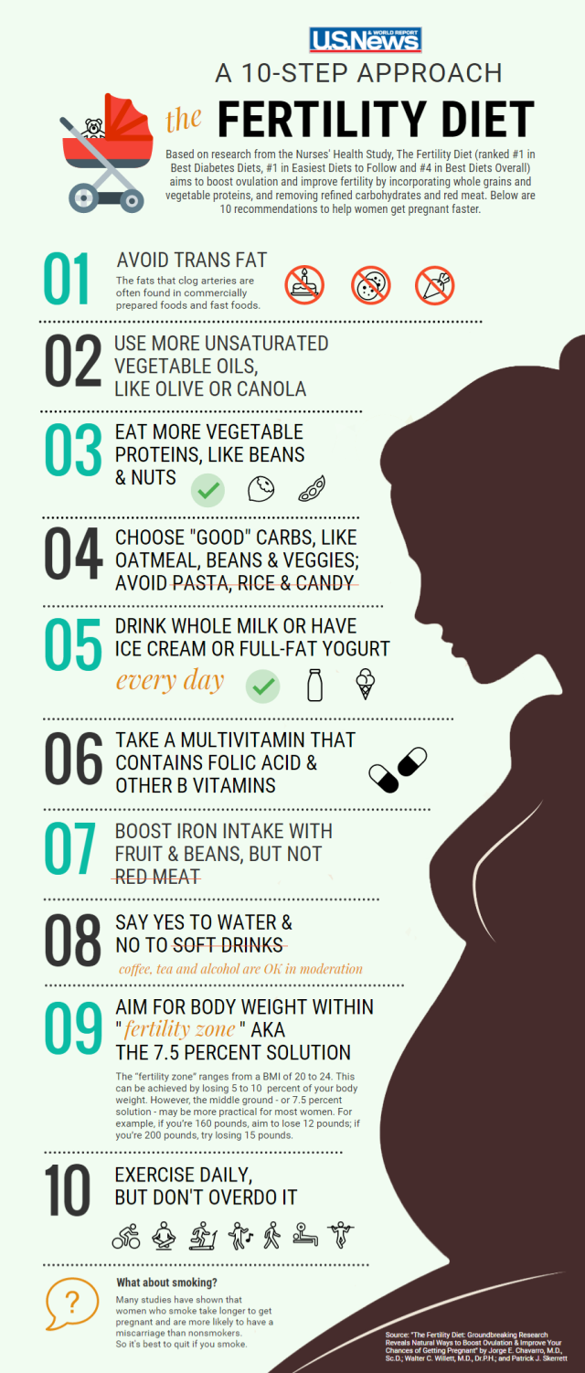

Slide 23
Grazie

